Slide 1


Call center
Nadali Khalili

Slide 2
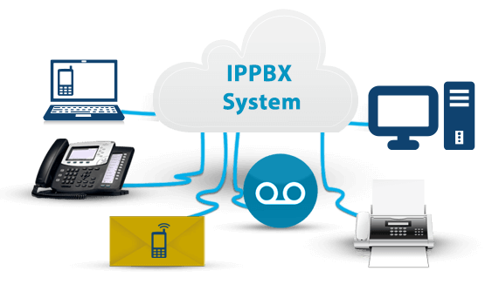
IP pbx

Slide 3
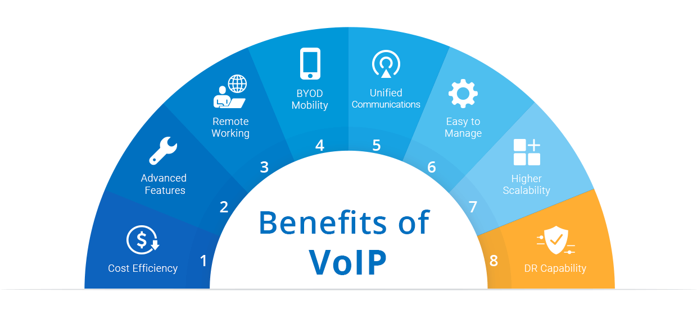
VoIp advantages

